Slide 1
BAS Automation Framework introduction
Jun Wang
2011.4.6

Slide 2
Agenda
Common Testing Challenges
BAS China Test Strategy
Our Solution
Cost Benefits
Features
Traditional Approach vs. BAS Approach
Logical Structure of Automation Framework/Approach
Process Control – Flight Planning Example
Summary

Slide 3
Common challenge for automation
The rising maintenance costs to deal with the frequency of system changes
Specialized skills are required for complex scripting
Management of changes to Test Assets is very difficult
Schedule constraints
Development
……
Coding
Test
……
Test Execution
Write Test Script
Issue
Notes:
3
进度的依赖——时间进度紧，但仅能再开发完成后才进行测试脚本开发
测试资产的无序管理——测试资产分散，脚本、日志、文件放在不同的目录，很难做到各类测试资产的统一管理和共享，即便采用拷贝方式统一存放，依然无法做到真正的统一管理
3

Slide 4
Different Stages of Automation Test
BAS Framework
Level 4
Business-driven by Key work
Level 3
Data Driven
Level 2
Programming and Playback
Level 1
Capture, Edit, Playback

Slide 5



Solution
User Case Categorization
Test Data
Test Object
Test Script
Test Scenario
Tools
A:Main Process
Global variables
Object Maintenance
Complex Scripting
Pre-Condition Setup
Data Generation tool
B:Sub Process
Data Collect
Object Identification
Business Logic
Object Generation tool
Component
Reuse & Remix
C:Funciton Check
Random Generation
Redundant Objects
Framework
Coding Standard
Post-Condition Setup
D:External Call
Data in Different ENV
Localization
Script Generation tool
E:Other
Data across Business/Script
Object Operation
Error Handling
Global configuration parameters
Configuration List
BPT
Data Driven
Dynamic Configuration
Uniform Rules
Free combination
A+B: Smoke Test
Multi-function data bus
Different objects operating mode
Specialized Cooperation
Capture real output on the screen
A~E: Regression Test
The public data pool
Regular Expressions
Single entry, multiple exit
Multi-level logging

Slide 6
Solution
Categorize User Cases for Different Automation Strategy
Main Stream of UC
Branches of UC
Function Check by Legal or illegal Input
External Call (Webservice Call)
Mock Module
A + B for Smoke Test
A+B+C+D+E for Regression Test
User Case Categorization
A:Main Process
B:Sub Process
C:Functioin check
D:External Call
E:Other

Slide 7
Solution
Test Data
Data Generation Tool
Public Data Pool
Data Bus
Test Object
Easy Maintenance.
Regular Expression.
Easy Scripting.
Test Scripts
Code Redundant Reduce.
Unified Error Handling
Unified Coding Standard
Enhanced Data-Driven (Intelligent Handling.)
Test Data
Test Object
Test Script
Global variables
Object Maintenance
Complex Coding
Data Collect
Object Identification
Business Logic
Random Generation
Redundant Objects
Coding Standard
Data in Different ENV
Localization
Data across Business/Script
Object Operation
Error Handling

Slide 8
Solution
Test Scenario:
Components/Scripts Reuse.
Easy Combination of Components/Scripts to Test Different Business Routes.
High Efficiency than BPT without cost
Easy Maintenance for Pre-condition/Post-Condition Setup
Quick Configuration for Different Environment
Test scenario
Pre-Condition Setup
Component
Reuse & Remix
Post-Condition Setup
Global configuration parameters

Slide 9
Solution
Test Tools:
Data Generation Test Tool
70% of the data generated automatically based on equivalence class.
2. Object Generation Tool
Generated in Excel for easy maintenance.
3. Framework
Unified management, high-efficiency, high-performance.
4. Script Generation Tool
Generate scripts for sub business process relying on main stream
5. General Support for Different Platforms
Java, Web, Terminal Emulator, Flex (Flash), Silverlight,
Webservice, Oracle, etc..
Tools
Data Generation tool
Object Generation tool
Framework
Script Generation tool
Configuration List

Slide 10
Cost Benefit
Data Preparation
50-70% Data Preparation Effort Reduced by Our Framework
15% Data Configuration Effort Reduced by Our Framework
Maintenance
60% Maintenance Cost Reduced by Our Framework
Configuration
Notes:
10

Slide 11
Features
Script: One page, one scripts.
Operation: Data control operation.
Data: Easy to maintenance.
Object: Easy to maintenance.
Role: Clear division
Maintenance: High efficiency
Notes:
11

Slide 12
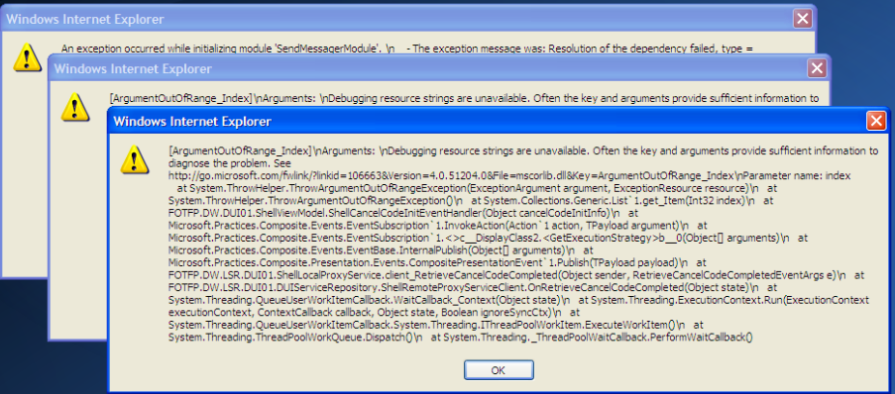
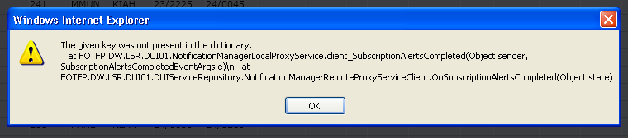
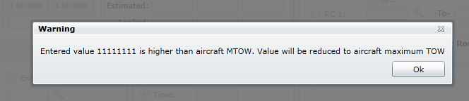
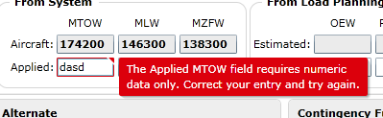
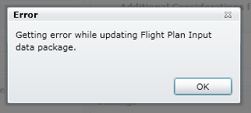

Script
One page, one scripts.
Unified Error handling
Main Process/Sub Process/Element check
Templates
Case No. | Case Description
042320_C001 | Main Process: Shortest key Path
042320_C002 | Main Process: Longest key Path
042320_C003 | Sub Process: Test: Select Calculate Max Payload
042320_C004 | Sub Process: Test: Select Calculate Max Payload; [Applied_MTOW] field with valid value
042320_C005 | Sub Process: Test: Select Calculate Max Payload; [Applied_MLW] field with valid value
042320_C006 | Sub Process: Test: Select Calculate Max Payload; [Applied_MZFW] field with valid value
042320_C007 | Pre-Condition for 042310: Select Calculate Max Payload; [OEW_applied] field with valid value
042320_C008 | Post-Condition for 042310; [PAYLOAD_applied] field with valid value
042320_C009 | Element Check: Valid Value in [OEW_applied] field
042320_C010 | Element Check: Test Invalid Value: large than [Aircraft MTOW] in [Applied_MTOW] field
042320_C011 | Element Check: Test Invalid Value: large than [Aircraft MLW] in [Applied_MLW] field
042320_C012 | Element Check: Test Invalid Value: large than [Aircraft MZFW] in [Applied_MZFW] field

Slide 13
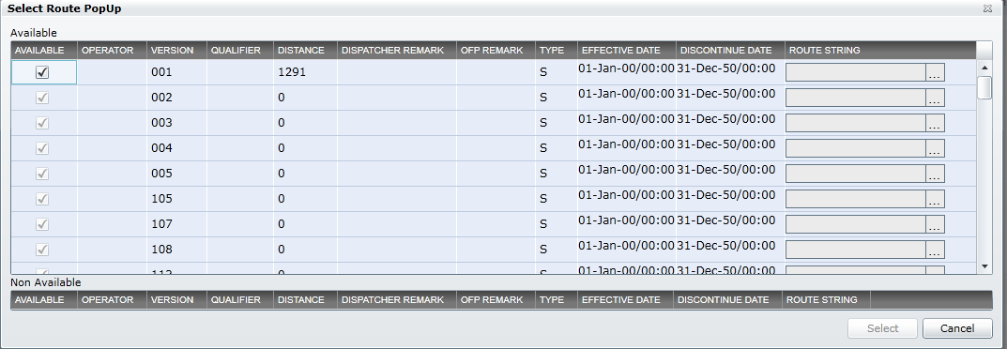
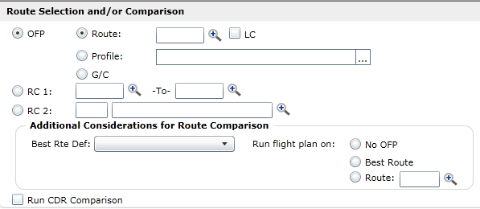
Operation
Data control operation.
EditBox, RadioButton, ComboBox, Checkbox, Objects
RadioGroupCheck
TableOperate
Other more operation
Call ABCAutoTest.SetValue("22120_EditBox ",slDicData.item(" Altitude_AlternateLeg_Max"),0,errMsg)
Call ABCAutoTest.RadioGroupOpt(slDicData.item("RadioButtonGroup"), errMsg)
All the operation of table should be defined in control data area
221410_radio_ContingencyFuel_Weight_R
:
221410_radio_ContingencyFuel_Time_R
:
221410_radio_ContingencyFuel_Time_R1
:
221410_radio_ContingencyFuel_Time_R2
:
221410_radio_ContingencyFuel_Time_R3
Altitude_AlternateLeg_Max | Operate
 | Nothing
1112312 | Error input
None | Clear EditBox value
600 | Correct Input
CheckProperty:text:600:0 | Check its' property 'text' is 600
CheckProperty:slvtypename:edit:0 | Check its' property 'slvtypename' is edit
CheckNull:True | Check if its value is Null
CheckExist | Check if object is exist
45%-tab
checkColName [AVAILABLE:OPERATOR:VERSION:QUALIFIER:DISTANCE:DISPATCHER REMARK:OFP REMARK:TYPE:EFFECTIVE DATE:DISCONTINUE DATE:ROUTE STRING]
CellSelect[4-2-celval]
CelValFind[2-101]
……
Select

Slide 14
Data
Easy to maintenance
Transfer variables
Unit Case data
Scene control
Case No. | Case Description | Max Payload | MTOW_applied | MLW_applied | MZFW_applied
042320_T001 | Main Process:Shorest key Path | 0 | 1000011
042320_T002 | Main Process:Longest key Path | 1 |  | 1000022
042320_T003 | Sub Process:Test: Select Calculate Max Payload | 0 |  |  | 1000033
042320_T004 | Sub Process:Test: Select Calculate Max Payload; [Applied_MTOW] field with valid value | 1 | get
042320_T005 | Sub Process:Test: Select Calculate Max Payload; [Applied_MLW] field with valid value | 0 |  | get
042320_T006 | Sub Process:Test: Select Calculate Max Payload; [Applied_MZFW] field with valid value | 0 |  |  | get
042320_T007 | Pre-Condition for 042310: Select Calculate Max Payload; [OEW_applied] field with valid value | 0 | AAA | None
042320_T008 | Post-Condition for 042310; [PAYLOAD_applied] field with valid value | 0 | CheckProperty:text:123456 | BBB
042320_T009 | Element Check: Valid Value in [OEW_applied] field | 0 |  |  | CCC
042320_T010 | Element Check: Test Invalid Value: large than [Aircraft MTOW] in [Applied_MTOW] field | 0 | 9999999
042320_T011 | Element Check: Test Invalid Value: large than [Aircraft MLW] in [Applied_MLW] field | 0 | Null | 9999999
042320_T012 | Element Check: Test Invalid Value: large than [Aircraft MZFW] in [Applied_MZFW] field | 0 | CheckExist | CheckExist | 9999999
Case No. | Case Description | Case Flag | Pre-Condition | Main Stream | Post-Condition | Case for Recovery
042320_T001 | Main Process:Shorest key Path | C001 | 042310:C002 | T001 | 042320:C012;042340:C006
042320_T002 | Main Process:Longest key Path | C002 | 042320:T004 | T002
042320_T003 | Sub Process:Test: Select Calculate Max Payload | C003 |  | T003
042320_T004 | Sub Process:Test: Select Calculate Max Payload; [Applied_MTOW] field with valid value | C004 | 042320:T006 | T004
042320_T005 | Sub Process:Test: Select Calculate Max Payload; [Applied_MLW] field with valid value | C005 |  | T005 |  | 023110:C002
042320_T006 | Sub Process:Test: Select Calculate Max Payload; [Applied_MZFW] field with valid value | C006 |  | T006
042320_T007 | Pre-Condition for 042310: Select Calculate Max Payload; [OEW_applied] field with valid value | C007 |  | T007
042320_T008 | Post-Condition for 042310; [PAYLOAD_applied] field with valid value | C008 |  | T008 | 042310:C009;042350:C001;023110:C008
042320_T009 | Element Check: Valid Value in [OEW_applied] field | C009 |  | T009
042320_T010 | Element Check: Test Invalid Value: large than [Aircraft MTOW] in [Applied_MTOW] field | C010 |  | T010
042320_T011 | Element Check: Test Invalid Value: large than [Aircraft MLW] in [Applied_MLW] field | C011 |  | T011
042320_T012 | Element Check: Test Invalid Value: large than [Aircraft MZFW] in [Applied_MZFW] field | C012 |  | T012
Sequence number | Case No. | Transaction Code | Used Flag | Execution time | Used time | Pre-processing Results
T0000001 | 042320_C001 | 042320 | Y | 2011-3-20 17:01:23 |  | Search flight:=0210|Date:=2011-03-11|Address1:=
T0000002 | 042310_C063 | 042310 | Y | 2011-3-26 16:36:25 |  | Search flight:=3021|Date:=2011-03-11|Address1:=

Slide 15
Object
Easy to maintenance
Common Objects.
Unit Objects.
Object Name | Object Type | Parent Object | Index | Text Expression
Browser0 | Browser | ROOT |  | title:=.*
Page | Page | Browser |  | title:=.*Signin.aspx.*
Browser1 | Browser | ROOT |  | title:=.*airservices.eds.com.*
Page1 | Page | Browser1 |  | title:=.*airservices.eds.com.*
UserName-login | WebEdit | Browser1 |  | name:=Login1.*UserName
Password-login | WebEdit | Browser1 |  | name:=Login1.*Password
RememberMe-login | WebCheckBox | Browser1 |  | name:=Login1\$RememberMe
AssDir-login | WebEdit | Browser1 |  | name:=Login1\$AssDir
Sign In-login | WebButton | Browser1 |  | name:=Sign\s*In
ErrMsg-login | WebElement | Browser1 |  | innertext:=.*Please try again.
Browser-DUI01 | Browser | ROOT |  | title:=DUI\-01
DUI-01 | Page | Browser-DUI01 |  | title:=DUI\-01
Loading | WebElement | DUI-01 |  | html tag:=FORM
Object Name | Object Type | Parent Object | Index | Text Expression
042320_edit_MTOW_aircraft | SlvEdit | Shell-02 |  | devname:=txtboxmtow
042320_edit_MTOW_applied | SlvEdit | Shell-02 |  | devname:=txtboxAppMtow
042320_edit_MLW_aircraft | SlvEdit | Shell-02 |  | devname:=txtboxmlw
042320_edit_MLW_applied | SlvEdit | Shell-02 |  | devname:=txtboxAppMlw
042320_edit_MZFW_aircraft | SlvEdit | Shell-02 |  | devname:=txtboxmzfw
042320_edit_MZFW_applied | SlvEdit | Shell-02 |  | devname:=txtboxAppMZfw
042320_tip_validationTooltip | SlvObject | Shell-02 |  | devname:=validationTooltip
042320_box_Max Payload | SlvCheckBox | Shell-02 |  | slvtypename:=check box;text:=Calculate Max Payload
042320_edit_OEW_estimated | SlvEdit | Shell-02 |  | devname:=txtboxMinOew

Slide 16
Role
Clear division (Total:7~11)
Expert
Number: 1~2
Design Framework.
Senior Automation Tester
Number: 2~3
Package Function.
Design Common Scripts & Unit Scripts.
Junior Automation Tester
Number: 4~6
Design Unit Scripts.
Design Test Scene.
Strong Scripting technology skills
Reduce the cost of manpower training
General Scripting technology skills
Rich business knowledge

Slide 17
Maintenance
High efficiency :
Case Data
1.Only add/modify in Unit/Global Sheets.
2.Transfer data shouldn’t be modify.
Scene Control
Only add/modify some items in Control Sheet.
Object Change
Only add/modify in Unit/Global Sheets
Script Modify
Usually we shouldn’t modify scripts, only to modify operate data in Data Sheet.

Slide 18

Traditional VS BAS Approach
Areas | Traditional Approach | BAS Approach
Scripting and Maintenance | Non-standard Object | Unified Object Handling
 | Complex Parent-Child Object Identification | Automatic Object Identification
 | Hard to Transfer Data across Different Business /Scripts | Solved by multi-function Data Bus All kinds of data can be transferred. Support by different languages No volume constraints
Object Library Maintenance and Management | Complex Maintenance | Easy maintenance with a few spreadsheets Easy maintenance by reducing redundant objects
 | Single Object Maintenance
 | Different Environments | Quick configuration to switch between different environments
Test Data Maintenance and Management | Data Issue | Public data pool
Notes:
18

Slide 19
Structure of Our Framework

Slide 20








Process control – FP Example
Working Flow
Flight
Confirm
Search
queries
Add/Delete/search/Modify
Data transfer
Calculate
Others
Summary
Scene control
Business
process drive
Data-Driven
Data pretreatment
Unit script, data, object
Logon
DUI-01
Search Flight
Calculate
Output
Notes:
20

Slide 21

DEMO

Slide 22
Development steps
Business analysis & data preparation.
Object preparation.
Common Object
Unit Object
Script preparation.
Develop, Modify, Debug.
Main Process, Sub Process, Function check,...
Scene preparation.
Pre-Condition & Post-Condition
Environment Parameters.
Transaction_Parameters.
Running

Slide 23
1.Business analysis
Shortest Critical Route.
Longest Critical Route.
Other Critical Route.
Sub business flow. (More)
Error handling.
Web service.
Other requirement.

Slide 24
2.data preparation
Case Description | Expected Results | Data 1 | Data 2 | Data 3 | … | Operate 1 | Operate 2 | Operate 3 | …
Shortest Critical Route | The pre-condition of other case
Longest Critical Route
Other Critical Route 1
Other Critical Route 2
…
Sub business flow 1
Sub business flow 2
…
Error handling._Control 1_Input error
Error handling._Control 3_No input
Error handling._Control 4_less than
…
Web service
Other requirement

Slide 25
3.Object preparation
1. Find common object.
2. Analyze unit object.
3. Find object’s key value.
4. Fill in excel.
5. Check the key value of objects.
Object Name | Object Type | Parent Object | Index | Text Expression
042320_edit_MTOW_aircraft | SlvEdit | Shell-02 |  | devname:=txtboxmtow
042320_edit_MTOW_applied | SlvEdit | Shell-02 |  | devname:=txtboxAppMtow
042320_edit_MLW_aircraft | SlvEdit | Shell-02 |  | devname:=txtboxmlw

Slide 26
4.Script preparation
Use the Templates and tool to develop Longest Critical Route.
Modify and debug it.
Add the sub flow in the script.
Add the error handling.
Verify all types of data inputs.
Check if the script can deal with all the correct and error input.
Add other requirement route.
Complete the unit script.

Slide 27
5.Scene preparation
Find the Pre-Condition & Post-Condition of this case.
Prepare the Environment Parameters.(Tell.xls)
Prepare the Transfer Parameter. (TestData.xls)
Debug.
Complete.
Will be other case’s Pre-Condition or Post-Condition.

Slide 28
Maintenance steps
Object changed;
Unit object
Common object
Business Flow changed (Scripts changed)
In one page
Scene changed
Data changed;
Global parameters
Non-critical data variables
Key value
Env changed;
Database
Env Merge or Transfer
New versions are released

Slide 29
Summary
Areas
Our Advantages
BPT management
Quick Configuration for Different Env
Intelligent Handling
Easy Combination of Components/Scripts
High Efficiency
Components/Scripts Reuse
Pre-condition/Post-Condition Setup
Data-Driven
Data Generation Tool
Public Data Pool
Data Bus
Unified Error Handling
Global configuration parameters
Special data-driven
Business-Driven
Main Stream
Branches of UC
Function Check
External Call
Mock Module
Other
Pre-condition
Post-Condition
Unified management
Regular Expression
Unified Error Handling
Unified Coding Standard
Data Generation Test Tool
Object Generation Tool
Script Generation Tool
Maintenance cost
50-70% Data Preparation Effort Reduced
15% Data Configuration Effort Reduced
60% Maintenance Cost Reduced
General Support for Different Platforms

Slide 30
Thank you！
Email: Jun.wang15@hp.com
MSN:Wangjun1983654@eyou.com

Slide 31
Supplement Material

Slide 32
Summary
Main characteristics below：
Business-driven
Overall business process use business-driven, which develop its script only need pay attention to overall business. The specific script is unnecessary to consider which is easy to design and can be developed in advance.
Data-driven
The transaction union use data –driven which can improve the rate of business coverage by increasing test cases.
Data is the interface between different union transactions, relatively independent for each other, easily maintenance, management and reuse.
Keyword-driven
The union script use keyword-driven. Develop scripts without dependent on stabbed procedures, which is easy to design and can be developed in advance.
Allowed configuration test objects recognition which is easy to design and can be developed in advance.
Configurable test object recognition
Base on the encapsulated of object test tool recognition mode, it is easily to maintenance and management, meanwhile the develop and maintenance cost is also lower.
Tests concentrating object library management
Use own technology of test object library management which make the maintenance and management easily and reduce development maintenance costs
It is independent of test programming. It can build object library when Interface design or prototype exit.
Test data management
Separate the teller data and Cycle testing data
Logically test data management
Business process is the main testing process. Data is the expression of all steps which designed for complex banking system.
Unified operation
Custom encapsulation by system characteristics
Independent on objects type
Notes:
32

Slide 33
Design thought of Framework
Reuse
“Reuse” is the central idea throughout the overall design and Local details
Uniform script framework , use function to encapsulate atomic transactions, unified interface, use data bus to transfer data, encapsulate public transactions/methods, use data pool to manage public data and basic data.
Use sample data sheet to manage object properties, unnecessary to consider the levels of object localization, configurable environmental object recognition mechanism.
The original union transaction/ test cases can be sharing for transaction function testing and business process testing.
Easy-to-use
Unified encapsulate various environmental objects’ different operations; Various flexible operation mode of expression; Need not consider levels of object localization; get rid of the complex management methods of the tool, use sample data sheet to manage; sample and unified driver entry;
High efficiency of Develop maintain
Comprehensive reuse and Easy-to-use design which can improve the develop efficiency, reduce the maintenance costs of scripts, objects, data;
Notes:
33

Slide 34
Test asset management process

Slide 35
The Main Function of Framework
Business process drive
Multi-function
data bus
The public
data pool
Framework
All
These
Data pretreatment
Script automatically
generated
Different objects
operating mode
Different objects
operating mode
Notes:
35
9
11

Slide 36
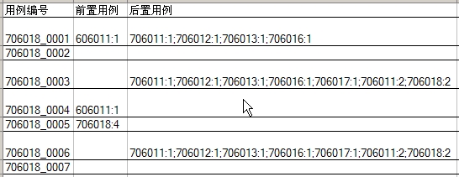
Business process drive
Constitute by Main cases、pre-cases、rear-mounted cases
Process drive can scheduling the related original union transaction by business process, and it can use corresponding test cases.
Notes:
36

Slide 37
Data BUS
Use same interface for every original union transaction;
Through the data BUS unified carrying all test data;
Free to send data BUS in adding new parameters;
The data BUS can cross trading transmission,
effectively in the whole business process.
Function T706111(ByRef IBPAutoTest,ByRef slDicData, lDicTxnTeller,
_ByRef oTestOutData,sTranCode,ByRef errMsg)
……
Call IBPAutoTest.Click("706111_btn_ Financing situation ")
Call IBPAutoTest.SetValue("706111_edt_tab2_ FBP amount ", slDicData(" FBP amount "))
Call IBPAutoTest.SetValue("706111_edt_tab2_ ratio ", slDicData(" ratio "))
Call IBPAutoTest.SelectItem("706111_lst_tab2_ Actual loan currency ", slDicData(" Actual loan currency "))
……
slDicData(" Operation results ") = " Successful trading :" & errMsg
Notes:
37

Slide 38
Public Data Pool
Key data(20%~30%)
Used to store and manage base data, public data
Base data
Middle-data(Transaction No. generated by system, etc…）
Management Unified by database
Shared in all execution process
Protection and distribution Public data
Non-primary data(70%~80%)
Automatically generated by tool
Random number generation method
Notes:
38

Slide 39
Data pretreatment
Generate data automatically through script, function and other various of methods
Generate data automatically through tools.
Use public data pool to manage pretreatment data
Notes:
39

Slide 40
Script Automatically generated
Generate script in various ways
Base on standardized keyword cases
Base on regular Interface describing documents to generate scripts, object library, data table, such as web page, XML etc…
Notes:
40

Slide 41
Different objects operating mode
Simplify multi-layer object localization to single-layer localization
Variety operation mode
Customized operation
such as SetValue、SelectItem、Click etc…
QTP operation such as Set、Select、Click etc…
Operation and property of QTP packaged controls
1. Call FP.SetValue("706111_edt_search_date ", slDicData(" search_date "))
2. FP.item(“706111_edt_search_date”).Set slDicData(" FBP amount ")
3. IBPAutoTest.item(“706111_edt_search_date”).Object. Func_or_prop [parms]
Notes:
41

Slide 42
Configurable Multi-platform Support
Realize object recognition through configuration files
Supporting coexist configurations in various environmental
Adjust configuration according by the actual circumstances without update script and object library
[WEBTABLE]
Class=WebTable
Index=WebTable
ID="ClassName"
IDVal="WebTable"
[DIALOG]
Class=Dialog
Index=Dialog
ID=
IDVal=
[WINBUTTON]
Class=WinButton
Index=WinButton
ID=
IDVal=
Notes:
42

Slide 43
Frame topology structure
Notes:
43

Slide 44
Framework Components
Catalogue classification management
Object data sheets
(According to transaction organized )
Unit scripts
(According to module organization)
Test cases and data
(According to the trade group )
Script library
(According to business organization)
Customize output result and screenshots
Notes:
44

Slide 45
Data-driven of Test composition
Organization with datamation and management test automation related content in order to adopt a more effective way of expression.
Already datamation content include : Business process, test data, test objects.
Pending to datamation include: test steps, test script.
Notes:
45

Slide 46
Framework Structure
Notes:
46

Slide 47
Human Resource Structure

